Slide 1
CSCI117: Introduction to Computers & Computing
“Computer Science is no more about computers than astronomy is about telescopes.” -Dijkstra
Dr. Emily Hill
Fall 2014

Slide 2
“Everybody in this country should learn how to program a computer… because it teaches you how to think.”
—Steve Jobs

Slide 3
Technology is increasingly transforming many aspects of our lives. Are you going to sit back and let others decide how technology will be used? Or are you going to be a part of that conversation?

Slide 4
Like any rewarding activity, CS can be challenging.
This course will challenge you.

Slide 5
Maze time!
START
END
Find a partner & grab a maze. Close your eyes while your partner directs you through the maze, then swap.
Notes:
Maze time! Bring paper with box on it. Pair up with eyes closed. Volunteer on board?

Slide 6
a-MAZE-ingly difficult
Giving precise directions can be challenging!
Leading someone through a maze
Writing a recipe
Giving directions to an unfamiliar location
Unlike humans, computers cannot “fix” ambiguous directions
How can we give computers precise directions? As programmers, we implement algorithms.
algorithm: a precise series of steps to accomplish a task
(i.e., solve a problem)

Slide 7
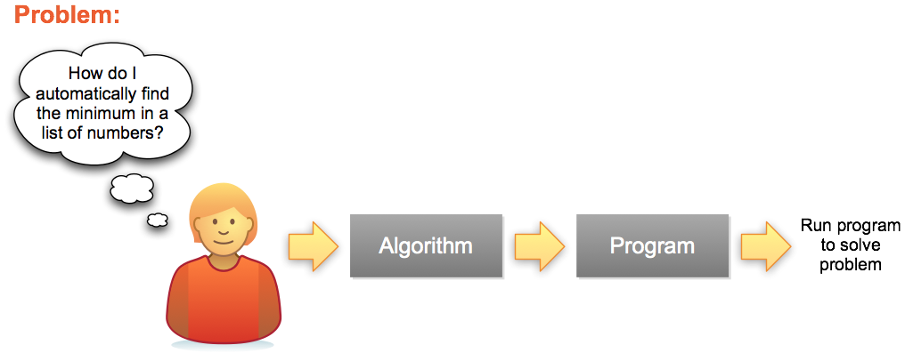
Problem Solving Process
Series of steps for any Programming Language
A specific implementation

Slide 8
The 7 “Habits” of Highly Effective Programmers
Concept
Example
Variables
Math
Functions
Input/Output (IO)
Conditionals
Lists
Loops
x = 5 hellothere = “howdy”
5 * 7 + a - 3 / b % 4 a is 5 AND x < 7 OR degree ≥ 98
f(x) = x²
print “Hello World”
if (x == f(x)) then print “x is 0 or 1” else print “x is not 0 or 1”
array = 1:5 array = 1, 4, 7, 8, a, b, c, d
foreach x in (array) print x
Notes:
In this assignment we'll investigate the 7 basic concepts in computer programming. Armed with an understanding of these 7 ideas, you could implement any program that's ever been written, in any programming language.
A little different from in the book
I/O often makes use of functions to implement
In using software, have you seen these ideas implemented in the past?

Slide 9
Problem Solving 101
Fundamental capabilities of any computer or programming language:
store single values x = 5 hellothere = “howdy”
store lists of values array = 1:5 array = 1, 4, 7, 8
functions f(x) = x²
conditionals if (x == f(x)) then print “x is 0 or 1” else print “x is not 0 or 1”
loop foreach x in (1:5) print x or foreach x in (array) print x
5 principles can combine in infinitely many ways – once mastered, you can create any program ever written!

Slide 10
These 7 concepts can be combined in infinitely many ways. Once mastered, you can implement any program that's ever been written, in any programming language.

Slide 11
What can you do with CS?

Slide 12



Matt Welsh
Senior software engineer at
Research: sensor networks
Variety of applications: monitor volcanoes, health care, …
Wrote Running Linux
Matt at Volcán Reventador in Ecuador

Slide 13
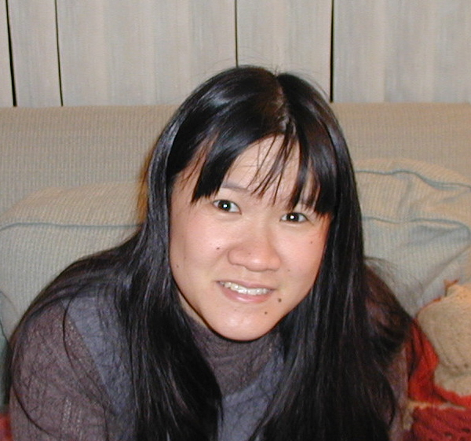

Jennifer Chu-Carroll
IBM Research Staff Member
Works on Watson
Advanced search technology through use of natural language processing and machine learning techniques

Slide 14
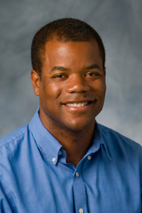
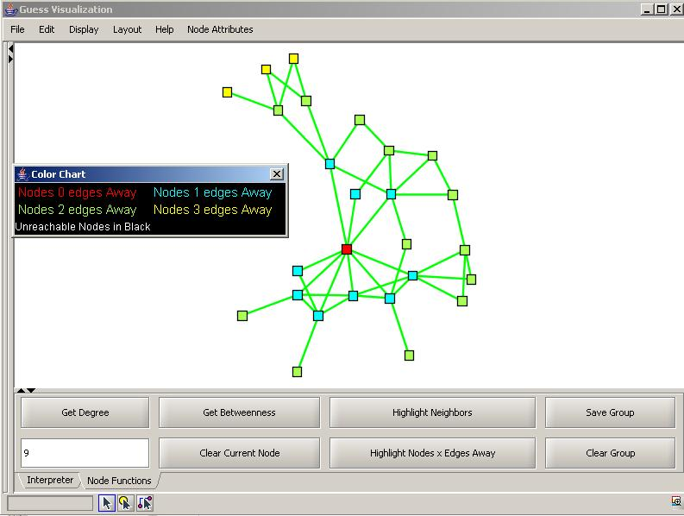
Jeff Forbes
Associate professor of the practice at Duke University
Focus: computer science education
Social networks, robotics
Currently a program director at National Science Foundation
Notes:
HarambeeNet: CS education via social networks
Works with local Durham schools teaching CS with robotics

Slide 15
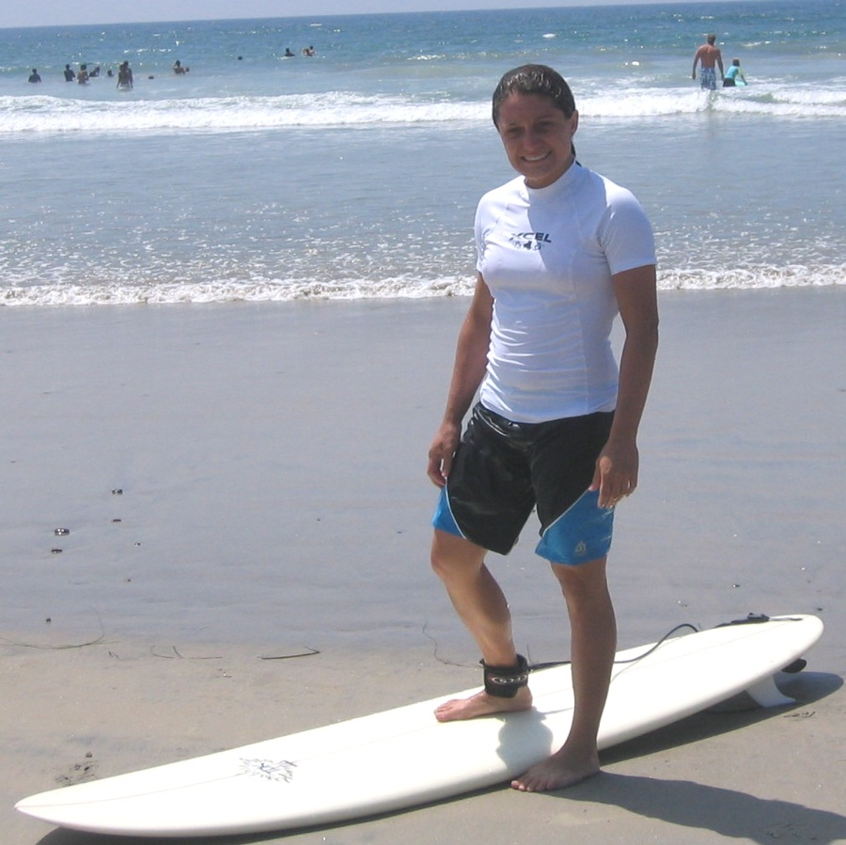
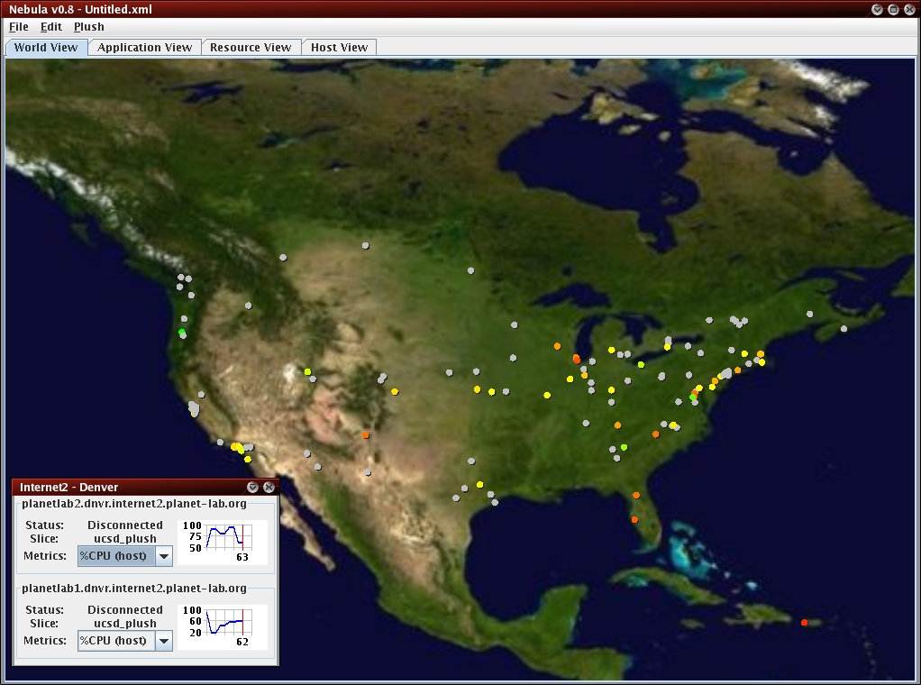
Jeannie Albrecht
Assistant professor at Williams College
Research: managing software running and communicating on computers around the world
Or in a building for energy efficiency
Hobbies: surfing, ultimate, rugby

Slide 16
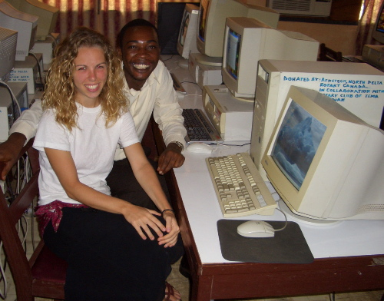
Sue Lister
Double major in CS and Psychology
Technical Lead at Clinton Health Access Initiative
Interested in decreasing the division between the technological haves and have nots
Only 11% of Africans have Internet access
Cell phones are commonly used
Sue with Alex, one of the computer teachers at Ketasco Secondary School, in the computer lab in Keta, Ghana
Notes:
Currently in Rwanda

Slide 17
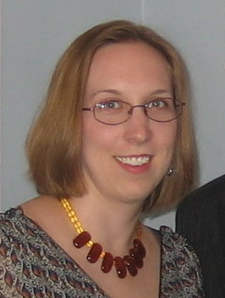
Christyann Pulliam
Double major in CS and Political Science from Gettysburg College
Law Degree from Wake Forest University
Patent Examiner at the US Patent and Trademark Office
Focus: Search engines, DB apps

Slide 18
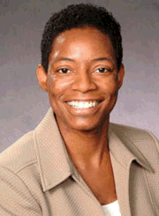
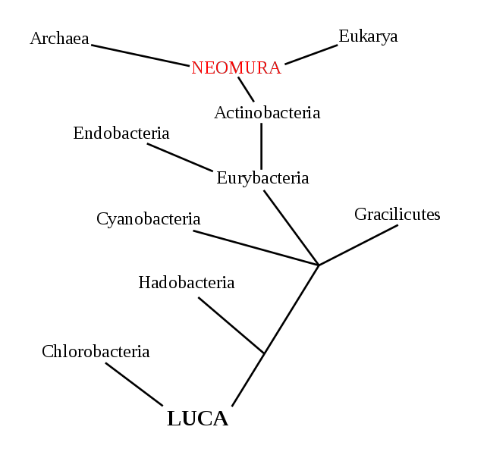
Tiffani Williams
Computational biology (bioinformatics) and high-performance computing
Develops software to analyze biological problems
Example: analyzing collections of evolutionary trees
Challenge beyond “real” problem: easy to use by biologists

Slide 19

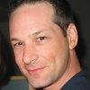
Erich Geist food banks
We use data analytics, computer systems, servers, programming, network and database administration all the time to provide the data necessary to inform our donors, government officials, advocates, and the general public about our mission to feed the hungry.
Without good computer science…there is no food.

Slide 20
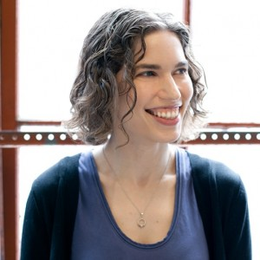
Hilary Mason
Chief Scientist, bitly
Data scientist and hacker
“finds sense in vast data sets”
“Teaching someone to program is like giving them a superpower.” quote in Glamour, November 2011

Slide 21
Why CSCI 117?
By the end of the course, you should be able to implement solutions to solve basic computational problems, including:
manipulating images
gaining insight from large data sets
analyzing social networks
You will learn Python, a popular and easy-to-use general-purpose programming language, and use it to implement your algorithms.
You will learn to navigate your computer and execute programs using the UNIX command-line interface.

Slide 22


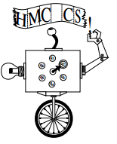


FREE Textbooks & Resources
Notes:
+ free online resources

Slide 23
How do you get to Carnegie Hall?
Practice!
Riding a bike, sports, music, foreign languages
Notes:
Bike, athletics, music, foreign language

Slide 24
Tips for success:
Practice coding every day. No excuses.
Google is your friend. Learn to use it effectively.
Be the leader of your learning. When you get stuck, answer the following questions:
What don’t I understand?
What do I expect to happen?
What is actually happening?
What resources can I use to understand better? (scientific method, google, peer, instructor, etc.)
Start early & work often
Notes:
To do add example self-help scenarios?

